Slide 1
ML@LSE - Bootcamp 4: Unsupervised learning
Ref. for today: Chapter 10, Hastie et al.

Slide 2
A- Principal Component Analysis (PCA)
Intuition of PCA
How to represent a galaxy in 2D?
PCA idea: maximize the variance
PCA algorithm
Finding the components
Proportion of variance explained
B- K-means Clustering
The intuition of K-MC
Why clustering?
K-MC finds partitions our data
K-MC algoritm
Within cluster variation
K-MC in practice
C- Hierarchical Clustering
The intuition of HC
A more flexible approach
The idea behind: agglomerative clustering
HC algorithm
Summary of the algorithm
Dendrograms
Unsupervised learning
So far we’ve studied supervised learning.
Each time we had a set of inputs (features) and we wanted to predict an
output.
Today we’re going to study a couple of unsupervised learning techniques.
In unsupervised learning, we only have features and no output variable.
We want to make sense of the set of features: finding useful way to
represent the data or finding patterns in the data.

Slide 3
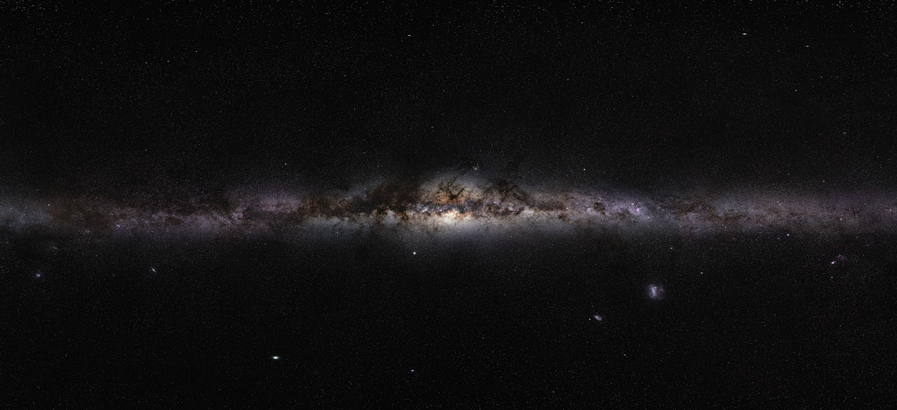
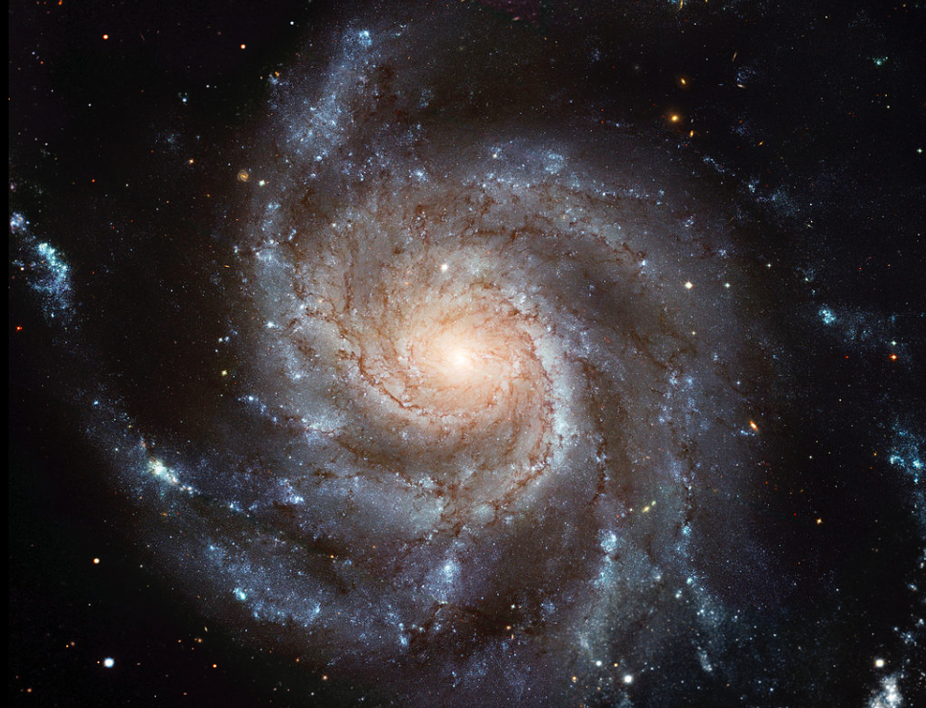
A- Principal Component Analysis (PCA)
Intuition of PCA
How to represent a galaxy in 2D?
PCA idea: maximize the variance
PCA algorithm
Finding the components
Proportion of variance explained
B- K-means Clustering
The intuition of K-MC
Why clustering?
K-MC finds partitions our data
K-MC algoritm
Within cluster variation
K-MC in practice
C- Hierarchical Clustering
The intuition of HC
A more flexible approach
The idea behind: agglomerative clustering
HC algorithm
Summary of the algorithm
Dendrograms
PCA intuition
How to represent a galaxy in two dimensions?

Slide 4
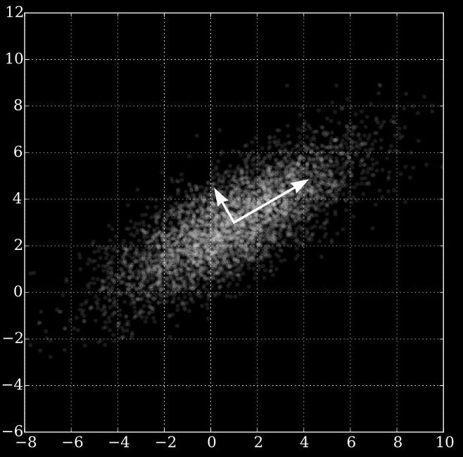
A- Principal Component Analysis (PCA)
Intuition of PCA
How to represent a galaxy in 2D?
PCA idea: maximize the variance
PCA algorithm
Finding the components
Proportion of variance explained
B- K-means Clustering
The intuition of K-MC
Why clustering?
K-MC finds partitions our data
K-MC algoritm
Within cluster variation
K-MC in practice
C- Hierarchical Clustering
The intuition of HC
A more flexible approach
The idea behind: agglomerative clustering
HC algorithm
Summary of the algorithm
Dendrograms
PCA finds the plane that maximizes the variance
The goal of PCA is to represent datasets on a lower dimension while
preserving a maximum of information.
This is done by projecting the data onto the plane that maximizes the
variance of the data.

Slide 5
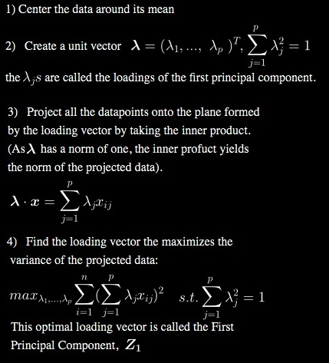
A- Principal Component Analysis (PCA)
Intuition of PCA
How to represent a galaxy in 2D?
PCA idea: maximize the variance
PCA algorithm
Finding the components
Proportion of variance explained
B- K-means Clustering
The intuition of K-MC
Why clustering?
K-MC finds partitions our data
K-MC algoritm
Within cluster variation
K-MC in practice
C- Hierarchical Clustering
The intuition of HC
A more flexible approach
The idea behind: agglomerative clustering
HC algorithm
Summary of the algorithm
Dendrograms
Finding the components
The goal of PCA is to represent datasets on a lower dimension while
preserving a maximum of information.
Let’s look at an animation to understand how to find the components.
⬅︎ For reference

Slide 6
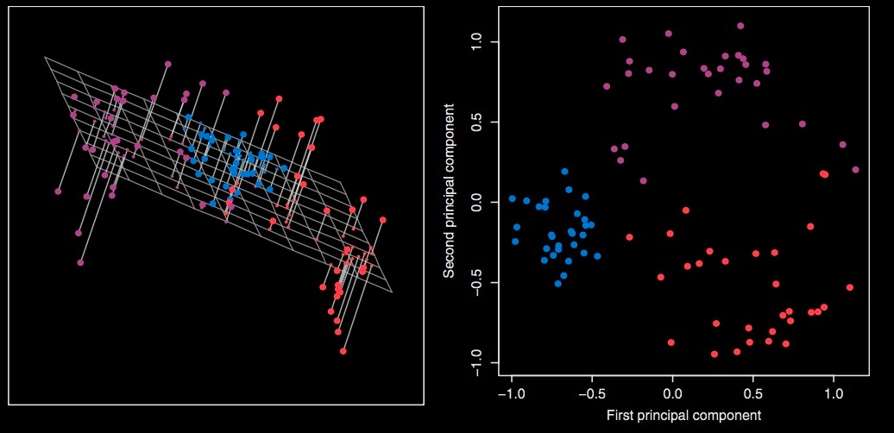
A- Principal Component Analysis (PCA)
Intuition of PCA
How to represent a galaxy in 2D?
PCA idea: maximize the variance
PCA algorithm
Finding the components
Proportion of variance explained
B- K-means Clustering
The intuition of K-MC
Why clustering?
K-MC finds partitions our data
K-MC algoritm
Within cluster variation
K-MC in practice
C- Hierarchical Clustering
The intuition of HC
A more flexible approach
The idea behind: agglomerative clustering
HC algorithm
Summary of the algorithm
Dendrograms
Finding the components
The second component Z2 has to be orthogonal to the first component
Z1, the third component Z3 has to orthogonal to both Z1 and Z2 etc…

Slide 7
A- Principal Component Analysis (PCA)
Intuition of PCA
How to represent a galaxy in 2D?
PCA idea: maximize the variance
PCA algorithm
Finding the components
Proportion of variance explained
B- K-means Clustering
The intuition of K-MC
Why clustering?
K-MC finds partitions our data
K-MC algoritm
Within cluster variation
K-MC in practice
C- Hierarchical Clustering
The intuition of HC
A more flexible approach
The idea behind: agglomerative clustering
HC algorithm
Summary of the algorithm
Dendrograms
Proportion of variance explained
We now have a set of principal components Z1, …, Zp.
Question: How much information do we loose by projecting our data
onto the first few Principal Components?
Similarly, how much of the total variance is not contained into the
first few principal components?
Proportion of variance explained (PVE):
Variance explained by the mth principal component
Total variance

Slide 8
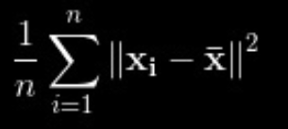
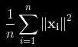
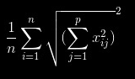
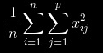
A- Principal Component Analysis (PCA)
Intuition of PCA
How to represent a galaxy in 2D?
PCA idea: maximize the variance
PCA algorithm
Finding the components
Proportion of variance explained
B- K-means Clustering
The intuition of K-MC
Why clustering?
K-MC finds partitions our data
K-MC algoritm
Within cluster variation
K-MC in practice
C- Hierarchical Clustering
The intuition of HC
A more flexible approach
The idea behind: agglomerative clustering
HC algorithm
Summary of the algorithm
Dendrograms
Proportion of variance explained
Total variance:
Variance = average of the squared deviations

Slide 9
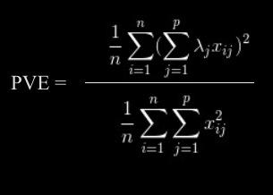
A- Principal Component Analysis (PCA)
Intuition of PCA
How to represent a galaxy in 2D?
PCA idea: maximize the variance
PCA algorithm
Finding the components
Proportion of variance explained
B- K-means Clustering
The intuition of K-MC
Why clustering?
K-MC finds partitions our data
K-MC algoritm
Within cluster variation
K-MC in practice
C- Hierarchical Clustering
The intuition of HC
A more flexible approach
The idea behind: agglomerative clustering
HC algorithm
Summary of the algorithm
Dendrograms
Proportion of variance explained
Proportion of variance explained (PVE):
Variance explained by the mth principal component
Total variance

Slide 10
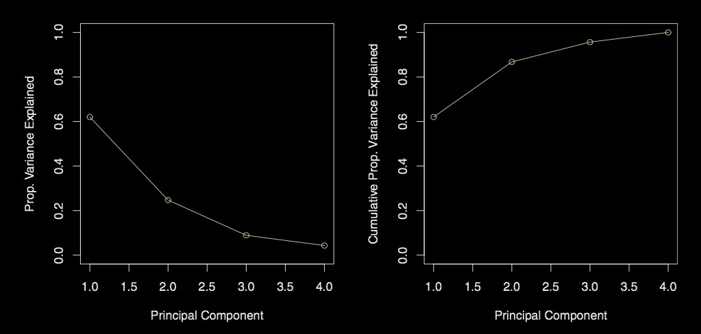
A- Principal Component Analysis (PCA)
Intuition of PCA
How to represent a galaxy in 2D?
PCA idea: maximize the variance
PCA algorithm
Finding the components
Proportion of variance explained
B- K-means Clustering
The intuition of K-MC
Why clustering?
K-MC finds partitions our data
K-MC algoritm
Within cluster variation
K-MC in practice
C- Hierarchical Clustering
The intuition of HC
A more flexible approach
The idea behind: agglomerative clustering
HC algorithm
Summary of the algorithm
Dendrograms
Proportion of variance explained: scree plots

Slide 11
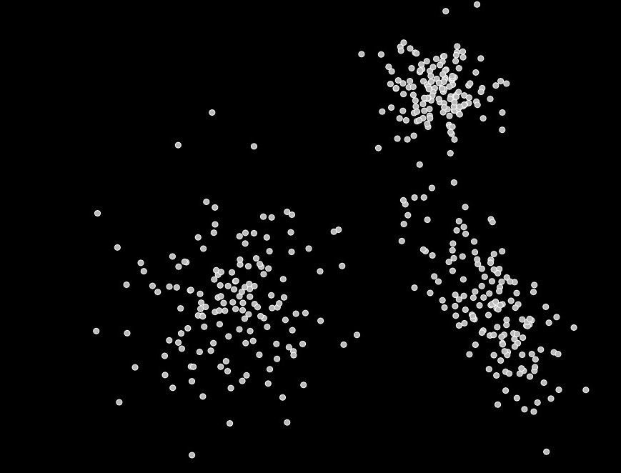
A- Principal Component Analysis (PCA)
Intuition of PCA
How to represent a galaxy in 2D?
PCA idea: maximize the variance
PCA algorithm
Finding the components
Proportion of variance explained
B- K-means Clustering
The intuition of K-MC
Why clustering?
K-MC finds partitions our data
K-MC algoritm
Within cluster variation
K-MC in practice
C- Hierarchical Clustering
The intuition of HC
A more flexible approach
The idea behind: agglomerative clustering
HC algorithm
Summary of the algorithm
Dendrograms
Clustering
PCA allowed us to reduce the dimension of our dataset without losing
too much information.
We might as well find patterns in our dataset. For example, we may want
to identify subgroups in the data, or clusters: this is called clustering.

Slide 12
A- Principal Component Analysis (PCA)
Intuition of PCA
How to represent a galaxy in 2D?
PCA idea: maximize the variance
PCA algorithm
Finding the components
Proportion of variance explained
B- K-means Clustering
The intuition of K-MC
Why clustering?
K-MC finds partitions our data
K-MC algoritm
Within cluster variation
K-MC in practice
C- Hierarchical Clustering
The intuition of HC
A more flexible approach
The idea behind: agglomerative clustering
HC algorithm
Summary of the algorithm
Dendrograms
Clusters partition our data
First clustering method: K-mean clustering
How does it work?
First we decide the number of clusters K we want to create
We want to put each of our datapoints into a cluster, hence the K clusters must not overlap and each datapoint must belong to one cluster.
We call our clusters C1, …, CK
K-mean clustering main idea: we want the observations in one cluster to be similar, i.e. we want the within-cluster variation to be as small as possible!

Slide 13
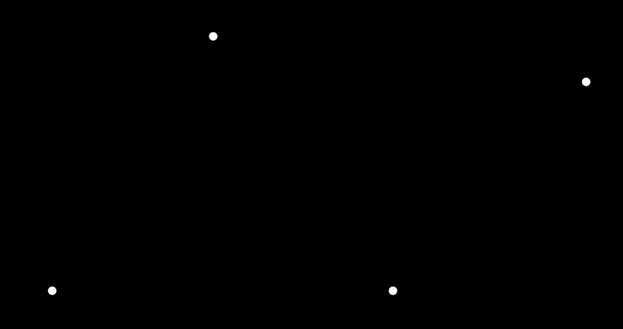
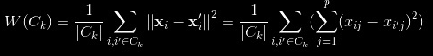
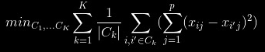
A- Principal Component Analysis (PCA)
Intuition of PCA
How to represent a galaxy in 2D?
PCA idea: maximize the variance
PCA algorithm
Finding the components
Proportion of variance explained
B- K-means Clustering
The intuition of K-MC
Why clustering?
K-MC finds partitions our data
K-MC algoritm
Within cluster variation
K-MC in practice
C- Hierarchical Clustering
The intuition of HC
A more flexible approach
The idea behind: agglomerative clustering
HC algorithm
Summary of the algorithm
Dendrograms
Within-Cluster variation
Now, what measure would you suggest to evaluate within-cluster variation?
We use the average square distances between each pair of observations in the cluster:
Ideally, we want to solve the program:
→ minimize the within-cluster variation!

Slide 14
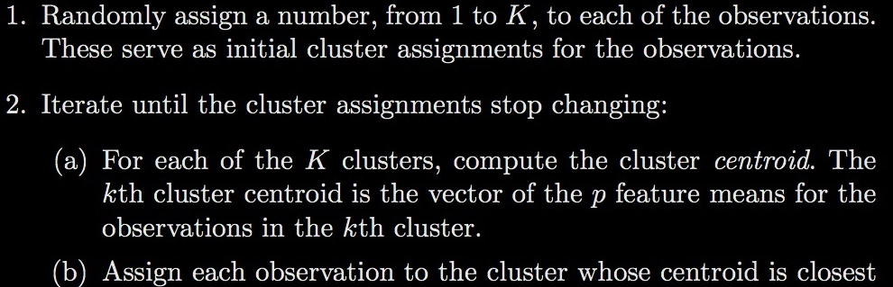
A- Principal Component Analysis (PCA)
Intuition of PCA
How to represent a galaxy in 2D?
PCA idea: maximize the variance
PCA algorithm
Finding the components
Proportion of variance explained
B- K-means Clustering
The intuition of K-MC
Why clustering?
K-MC finds partitions our data
K-MC algoritm
Within cluster variation
K-MC in practice
C- Hierarchical Clustering
The intuition of HC
A more flexible approach
The idea behind: agglomerative clustering
HC algorithm
Summary of the algorithm
Dendrograms
K-MC Algorithm
Unfortunately, the program
is difficult to solve since there are about K-combination n ways to combine the observations into K clusters.
BUT the following algorithm provides a locally optimal solution:
(locally optimal means that even if the solution is not the best of all solutions, it’s a pretty good solution)
K-Mean algorithm:

Slide 15
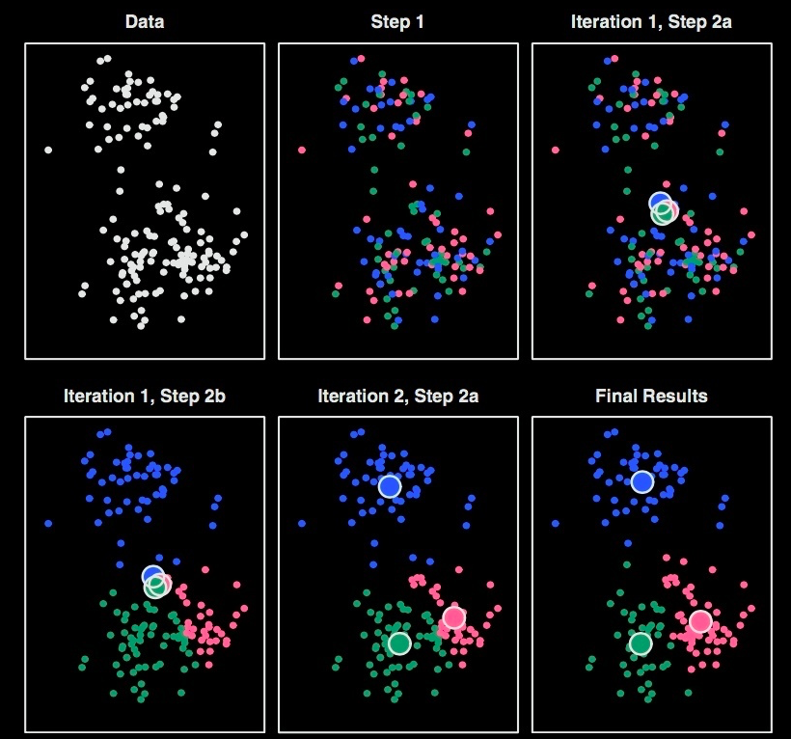
A- Principal Component Analysis (PCA)
Intuition of PCA
How to represent a galaxy in 2D?
PCA idea: maximize the variance
PCA algorithm
Finding the components
Proportion of variance explained
B- K-means Clustering
The intuition of K-MC
Why clustering?
K-MC finds partitions our data
K-MC algoritm
Within cluster variation
K-MC in practice
C- Hierarchical Clustering
The intuition of HC
A more flexible approach
The idea behind: agglomerative clustering
HC algorithm
Summary of the algorithm
Dendrograms
K-MC Algorithm

Slide 16
A- Principal Component Analysis (PCA)
Intuition of PCA
How to represent a galaxy in 2D?
PCA idea: maximize the variance
PCA algorithm
Finding the components
Proportion of variance explained
B- K-means Clustering
The intuition of K-MC
Why clustering?
K-MC finds partitions our data
K-MC algoritm
Within cluster variation
K-MC in practice
C- Hierarchical Clustering
The intuition of HC
A more flexible approach
The idea behind: agglomerative clustering
HC algorithm
Summary of the algorithm
Dendrograms
Hierarchical clustering
Problem with K-mean clustering: it requires us to pre-specify some structure on the data (by choosing the number of clusters K).
Hierarchical clustering is another clustering method that doesn't require this specification, and it is therefore more general.

Slide 17
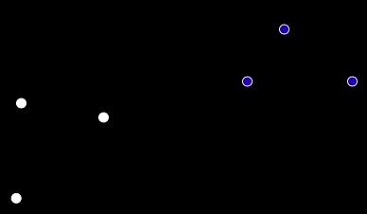
A- Principal Component Analysis (PCA)
Intuition of PCA
How to represent a galaxy in 2D?
PCA idea: maximize the variance
PCA algorithm
Finding the components
Proportion of variance explained
B- K-means Clustering
The intuition of K-MC
Why clustering?
K-MC finds partitions our data
K-MC algoritm
Within cluster variation
K-MC in practice
C- Hierarchical Clustering
Preliminaries
A more flexible approach
Agglomerative clustering and dissimilarity between clusters
HC algorithm
Summary of the algorithm
Dendrograms
Agglomerative clustering
The idea of hierarchical clustering is to progressively build up clusters of observations.
To do this we need an important concept: the dissimilarity between two clusters.
Minimal Intercluster Dissimilarity: Compute all pairwise distances between the observations in cluster A and the observations in cluster B, and record the smallest of these dissimilarities.

Slide 18
A- Principal Component Analysis (PCA)
Intuition of PCA
How to represent a galaxy in 2D?
PCA idea: maximize the variance
PCA algorithm
Finding the components
Proportion of variance explained
B- K-means Clustering
The intuition of K-MC
Why clustering?
K-MC finds partitions our data
K-MC algoritm
Within cluster variation
K-MC in practice
C- Hierarchical Clustering
Preliminaries
A more flexible approach
Agglomerative clustering and dissimilarity between clusters
HC algorithm
Summary of the algorithm
Dendrograms
The Algorithm
Let’s run the algorithm manually

Slide 19
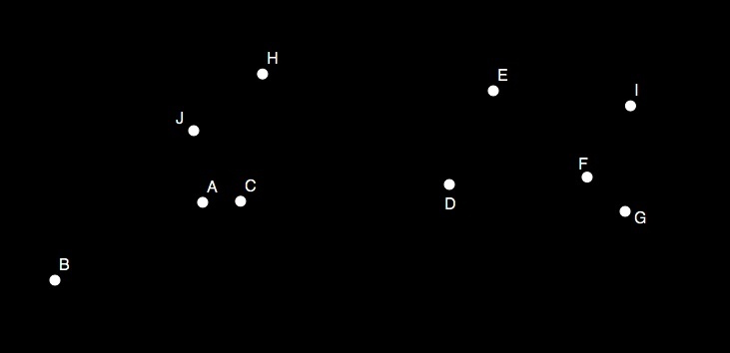
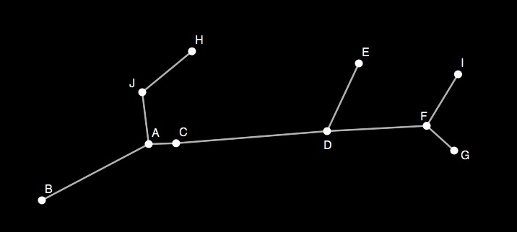
A- Principal Component Analysis (PCA)
Intuition of PCA
How to represent a galaxy in 2D?
PCA idea: maximize the variance
PCA algorithm
Finding the components
Proportion of variance explained
B- K-means Clustering
The intuition of K-MC
Why clustering?
K-MC finds partitions our data
K-MC algoritm
Within cluster variation
K-MC in practice
C- Hierarchical Clustering
Preliminaries
A more flexible approach
Agglomerative clustering and dissimilarity between clusters
HC algorithm
Summary of the algorithm
Dendrograms
Dendrogram
H-Clustering allows for a useful representation: the Dendrogram
A | C | J | H | B | G | F | I | D | E

